Slide 1



Slide 2

PaidPloy
Employer for employee

Slide 3




Management Team
Team members – names & titles
Relevant knowledge, skills, experience
Nasif Shahrier
Mashruba Momo
191-15-12257
191-15-12249

Slide 4

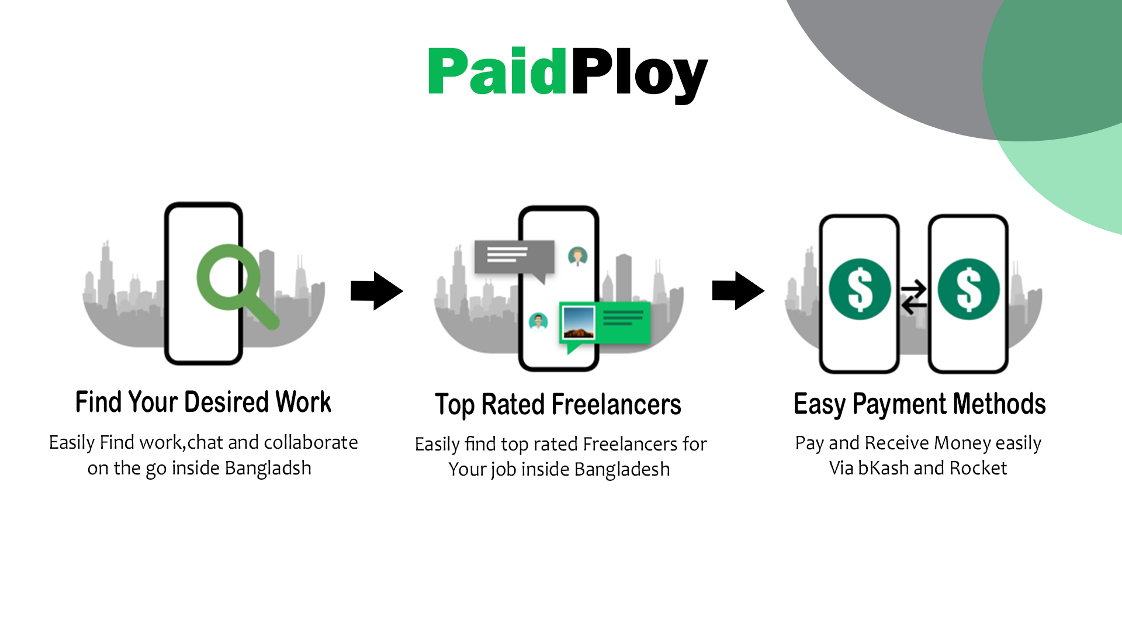

Introduction :
Company name:
PaidPloy
Company logo :
PaidPloy
Tag line: Employer for employee

Slide 5


Problems :
Transaction problem
Trouble to Finding work around the world
Trust issues

Slide 6





Trouble to Finding work around the world
Solving the Transaction problem
Trust issues

Slide 7

Mission and objectives :
# Make a safe place for the BD freelancers.
# Easy and safe payment methodes.

Slide 8



Everyone can be a member of our community
provide jobs for freelancers all over the world
Everyone can be a member of our community

Slide 9



USE CASE
login
Register
USER
ADMIN
Analyze Data
Find Work
Logout

Slide 10

Gantt Chart
In here we can see that 1st column is showing our brain storming progress day. 2nd column showing our planning days. And 3rd column showing our project file ready and when we submitted it.
Brain storming
You can simply impress your audience and add a unique zing.
Planning
We took 10 days to make our project plan and strategy
Project file submit
After all brain storming and planning to submitted our project file in 5 days

Slide 11

Thank You

